Slide 1
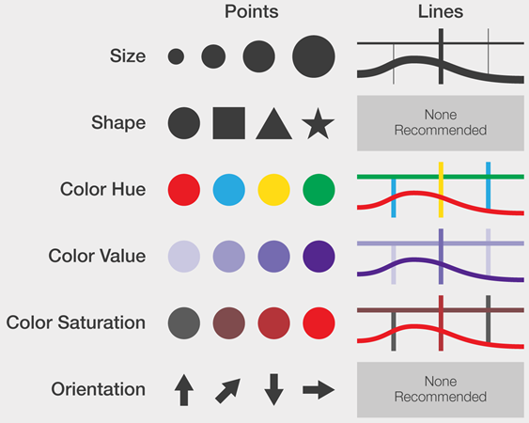
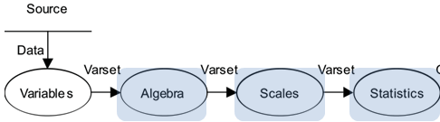
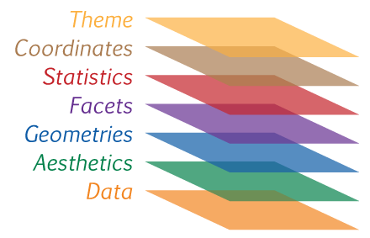
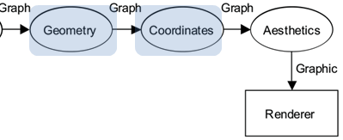
The Language of Graphs: from Bertin to GoG to ggplot2
Michael Friendly
Psych 6135
https://friendly.github.io/6135/

Slide 2
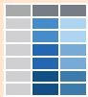
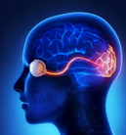

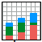
Meta questions
How did we get from early ideas of graph types (line, bar, pie charts, scatterplots, …) to expressing those in modern software?
data
idea
code
graph
What new thinking was required?
How to formalize different kinds of graphs and their attributes?
How to make the language of a graph express what we want to see?
How to do that most simply, elegantly, and generalizable?
Notes:
I know you are all really keen to get on to learning how to make compelling graphs with ggplot.
But I want to focus today on the larger, meta questions of how we got to the very idea of computer languages for graphics

Slide 3
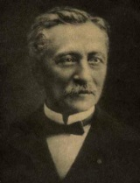
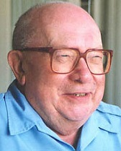
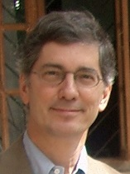

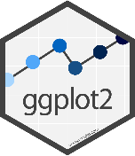
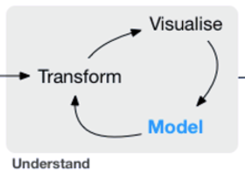

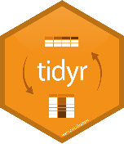

Topics
Idea: Graphs as visual language
Early attempts at standardization of graphs
Jacques Bertin: Semiology of Graphics
Mapping of visual properties to data relations
Graphics programming languages:
Goal: power & elegance
Lee Wilkinson: Grammar of Graphics
Hadley Wickham: ggplot2
Graphs in data science

Slide 4
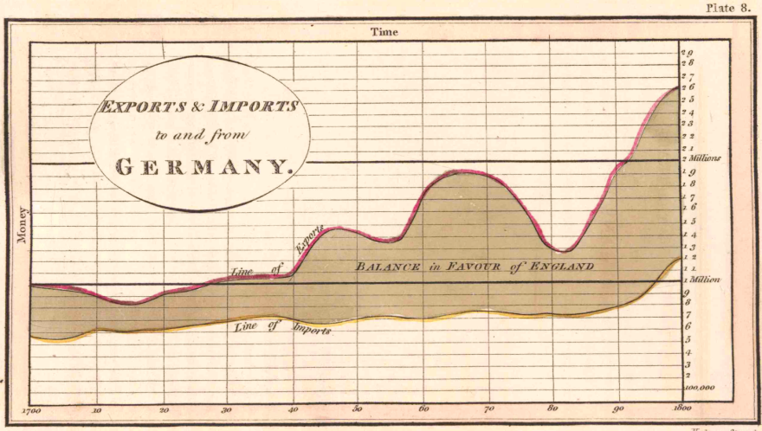
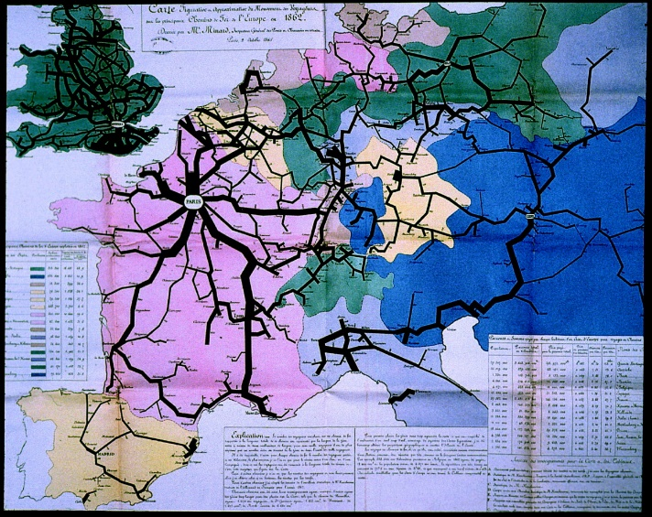
Metaphor: Graphs as visual language
Playfair, Guerry, Minard and others described their fundamental insight that graphical displays convey quantitative data more directly than numbers.
Playfair (1802)
“Regarding numbers and proportions, the best way to catch the imagination is to speak to the eyes”
Minard (1861)
“The aim of my carte figurative is … to convey promptly to the eye the relation not given quickly by numbers requiring mental calculation.”

Slide 5
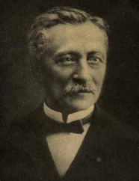
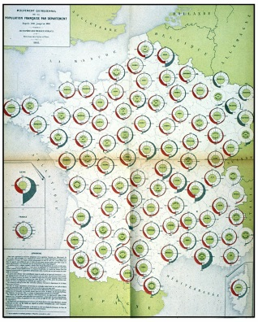
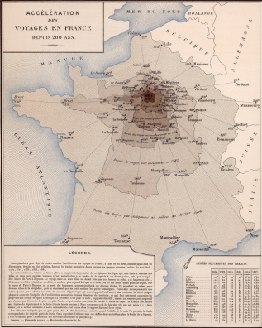
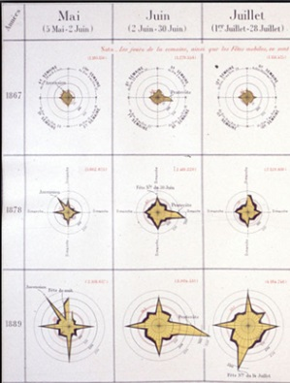
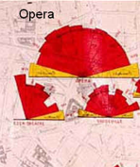
Metaphor: Graphs as visual language
Émile Cheysson (1890) took this further:
“When a law is contained in figures, it is buried like metal in an ore; it is necessary to extract it. This is the work of graphical representation.
It points out the coincidences, the relationships between phenomena, their anomalies, and we have seen what a powerful means of control it puts in the hands of the statistician to verify new data, discover and correct errors with which they have been stained.”

Slide 6
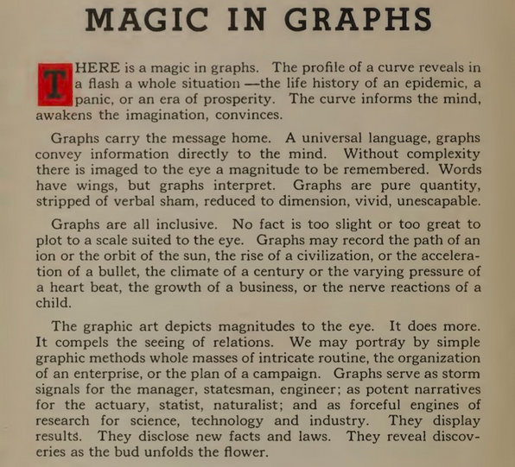
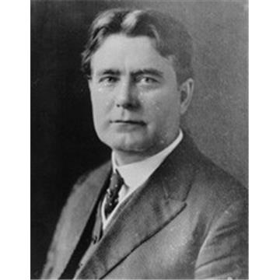
Willard C. Brinton: An ode to graphs
W. C. Brinton,
Graphic Presentation, 1939

Slide 7
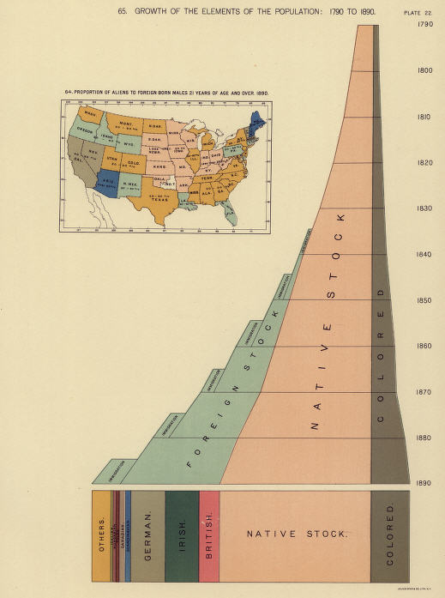
Context: Statistical albums, 1870-1910
From ~ 1870—1910, statistical albums of official statistics on topics of population, trade, moral & political issues became widespread throughout Europe and the U.S.
France: Album de Statistique Graphique: 1879-1899 (trade, commerce & other topics)
USA: Census atlases: 1870/80/90--
Switzerland: Atlas graphique de la Suisse:1897, 1914

Slide 8
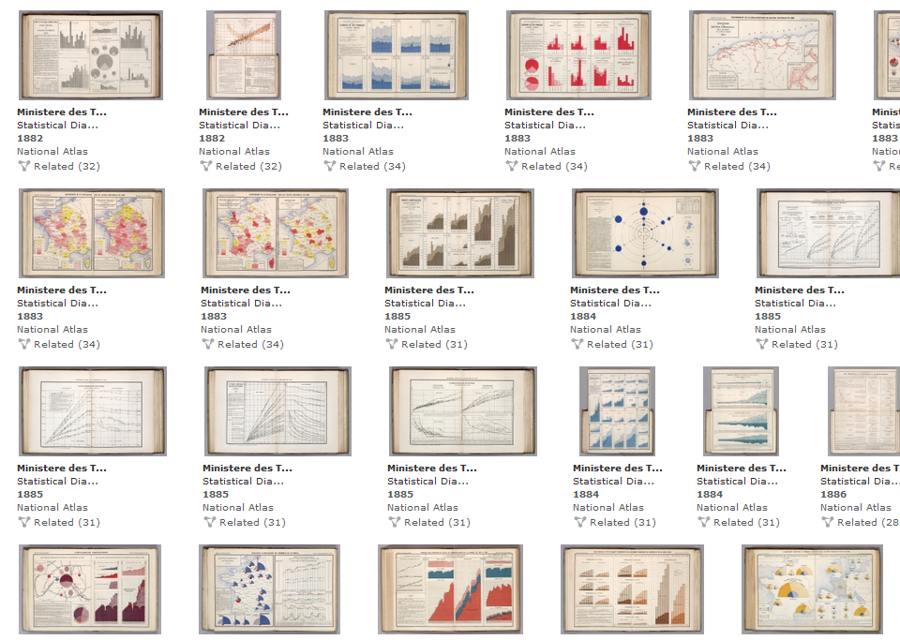
Notes:
In particular, the Albums de Statistique Graphique, directed by Emile Cheysson, expanded greatly the range of graphic methods

Slide 9
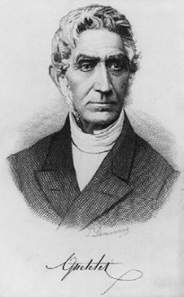
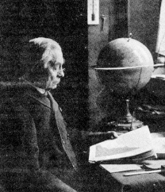
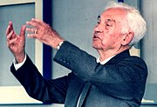
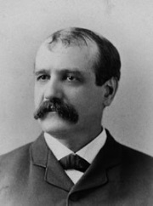
Need for standardization
Beautiful graphics: Yes, but all separate designs
Can anything be compared across countries?
Émile Cheysson (1878)
“The time will come when Science has to lay down general principles and decide on well-defined standards. We can no longer tolerate this sort of anarchy“
International statistical meetings (ISI)
1852 (Brussels), 1857 (Vienna), 1869 (The Hague), 1872 (St. Petersburg), 1876 (Budapest) …
Participants: Quetelet, Cheysson, Levasseur (France), Ernest Engel, Gustav von Mayr, Hans Schwabe (Germany), Francis Walker (U.S.), …
Cheysson
Quetelet
Levasseur
von Mayr
Walker

Slide 10

No consensus, but the germ of an idea
ISI St. Petersburg (1872) resolutions:
“The Congress accepts that it is not worth going into details about the choice of methods or facts for graphical representation”.
“no strict rule can be imposed on authors, because the only real problem is that of applying the graphical method to data that is comparable”.
Most of the debate had to do with thematic maps
number of class intervals for a quantitative variable
number and variety of shading colors
Yet, the idea of a visual language had been accepted, along with the need for some theory of graphs
Standardize the data before the graphs!
Fast forward

Slide 11
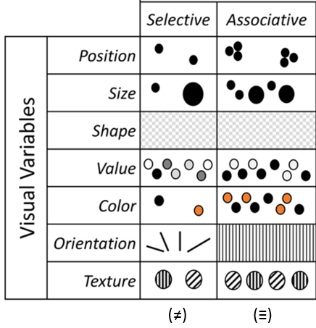
Bertin: Modern theory of data graphics
A Semiology of graphics:
Visual variables
Decoding: Reading levels of a graph
Reorderable matrix
Notes:
Jean Jacques Bertin was the first to design a modern understanding of graphs in terms of the meaning, or semiology of visual elements and their purposes.

Slide 12
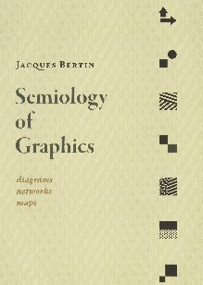

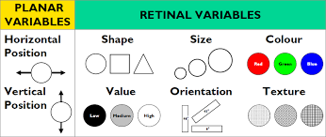
Bertin: Semiology of graphics (1967)
Defines a system of “grammatical elements” of graphs and relations among visual attributes that give meaning (semantics) from perceptual features
Planar variables: (x,y) coordinates
Retinal variables: shape, size, color, …

Slide 13
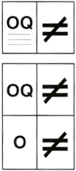
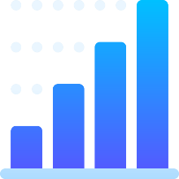

Bertin: Semiology of graphics
Defines a system of mapping retinal variables (marks) to properties of data variables for perception of relations
Association (≡) – marks are perceived as similar/same
Selection (≠) – marks are perceived as forming classes
Order (O) – marks are perceived as showing order
Quantity (Q) – marks are perceived as proportional
The first theory of graphs relating visual attributes (encoding) to perceptual characteristics (decoding).
BONUS: It comprises nearly all known graph and thematic map types in a general system
encode
view
decode

Slide 14
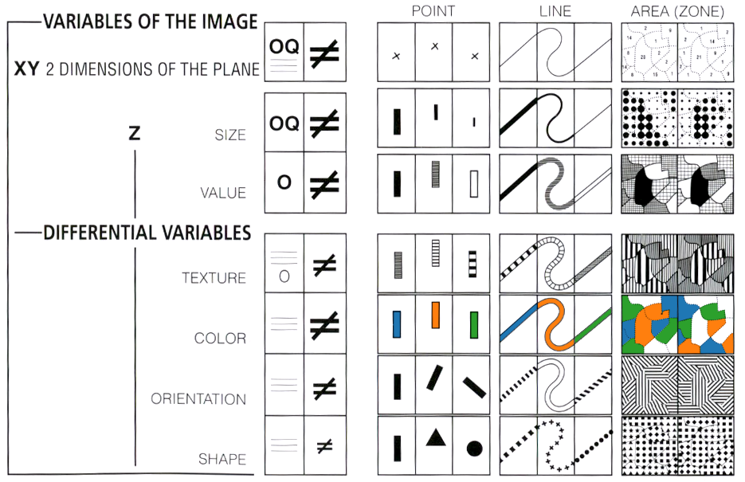
The retinal variables and relationship types can be “implanted” in various symbol types in the plane (X,Y)

Slide 15
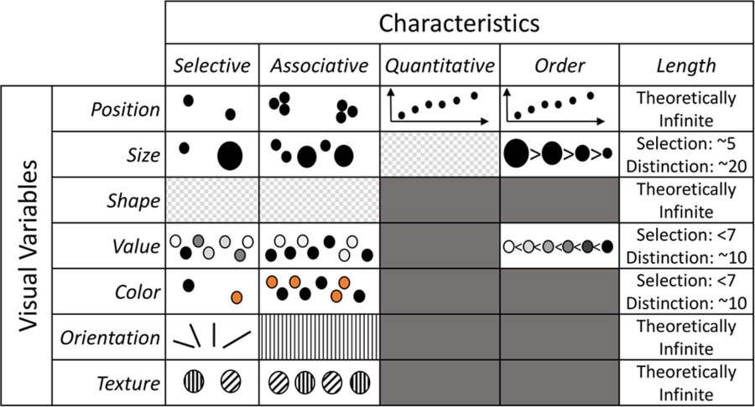
Visual variables & data characteristics
Visual variables differ in the kinds of information they can convey
(≠)
(≡)
(Q)
(O)

Slide 16
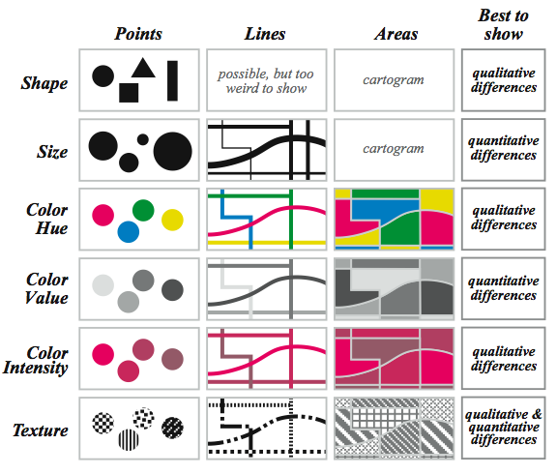

Some recommendations
Various authors have used Bertin’s system to make recommendations for the best attributes to use with different symbol types
(≠, ≡)
(O, Q)
(≠, ≡)
(O, Q)
(≠, ≡)

Slide 17
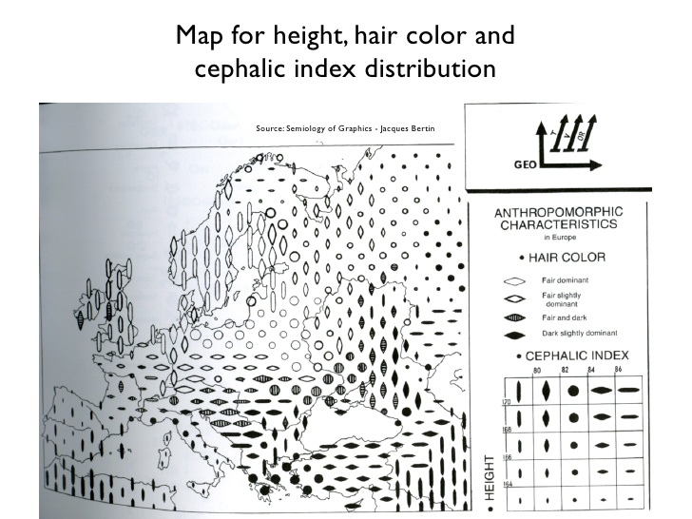
Retinal variables allow several variables to be encoded together.
Bertin’s system provides a general framework for thematic mapping, allowing multiple variables to shown simultaneously in a single map.
Legend:
GEO: (x,y)
T, V, OR: ordered
For Bertin, the legend is a symbolic description of the coordinate system and variables displayed.

Slide 18
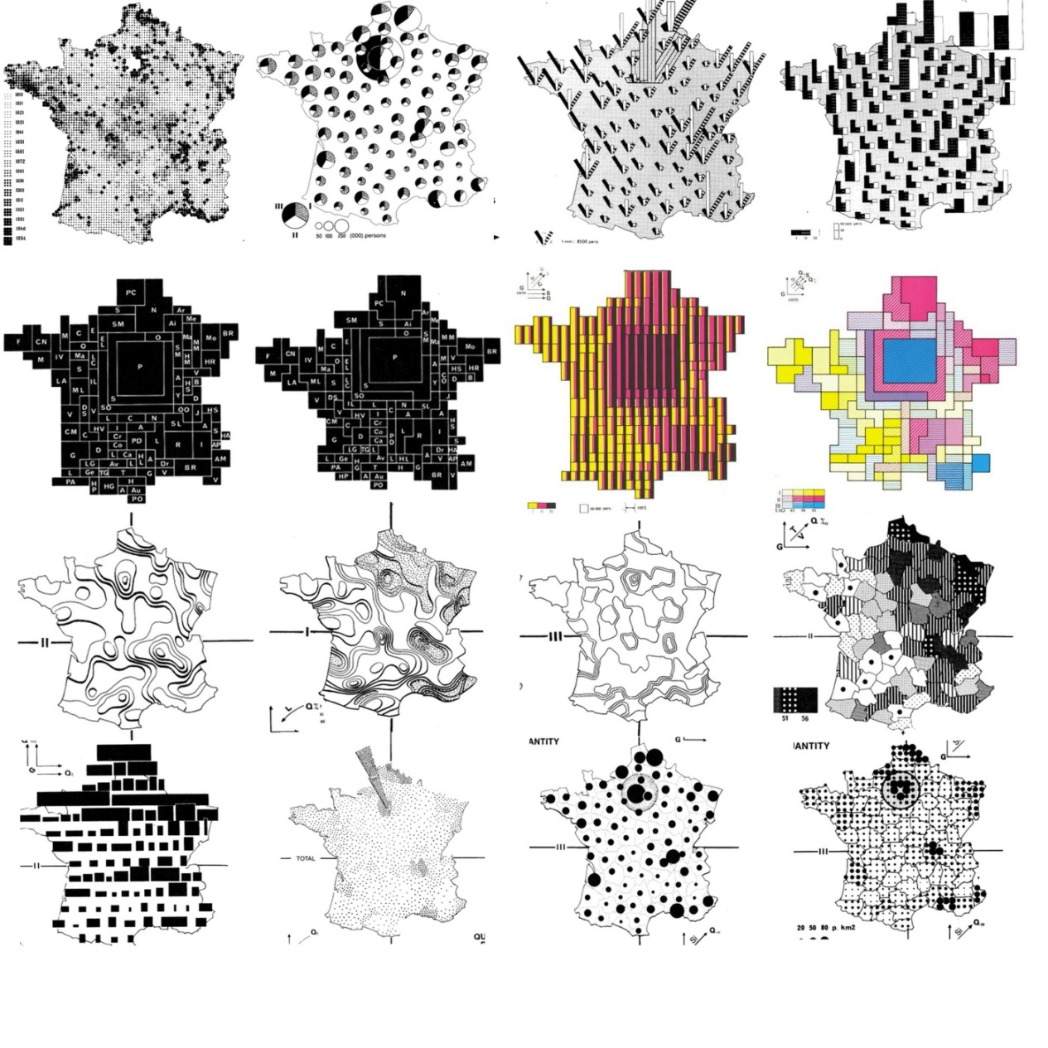
Various maps of France, encoding quantitative and categorical variables in a wide number of different ways.
This semiology is productive, as is the semiology of language.
Allows one to imagine new graphic encodings.

Slide 19
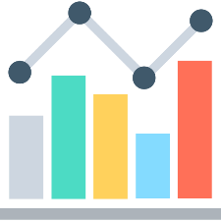

Decoding: Reading a graphic
How successful is a graph for transmitting information?
Bertin defines three stages for reading a graphic:
External: What is the overall context?
Graph title, axis labels
Internal: What visual variables are used to represent the components in the graphic?
points, lines, …
size, shape, color:hue, color:intensity, texture, …
Relationships:
How are these components related?
What questions can I ask of this graphic?
What can I learn?
Research topic: Have there been any studies of this ordering in graph perception?
Notes:
Bertin went much further. He tried to connect what was encoded in a graph to the mental operations of a person reading a graph.

Slide 20
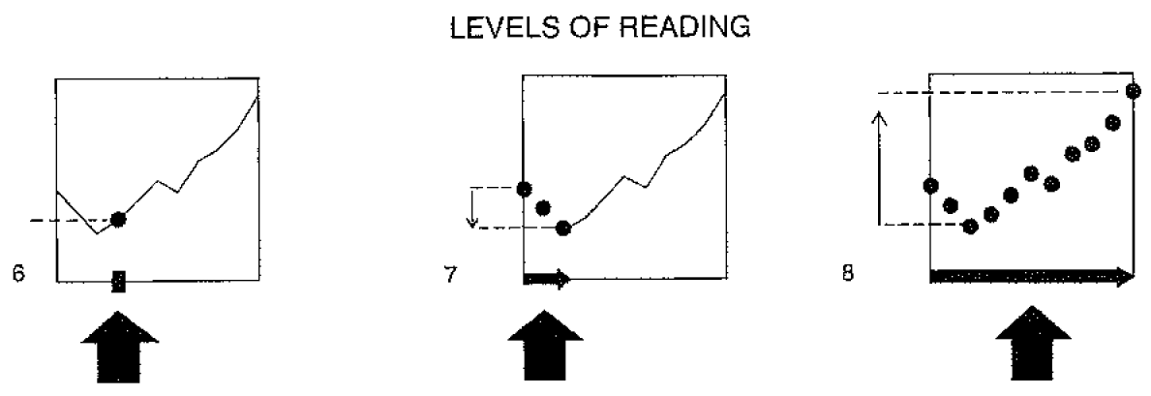
Reading levels
Questions a graph should answer:
Elementary: find some specific value
Intermediate: make comparisons, see a trend
Overall: what is the general message or overall trend?
These ideas provided the beginnings of a theory of graphs related to graph perception.

Slide 21
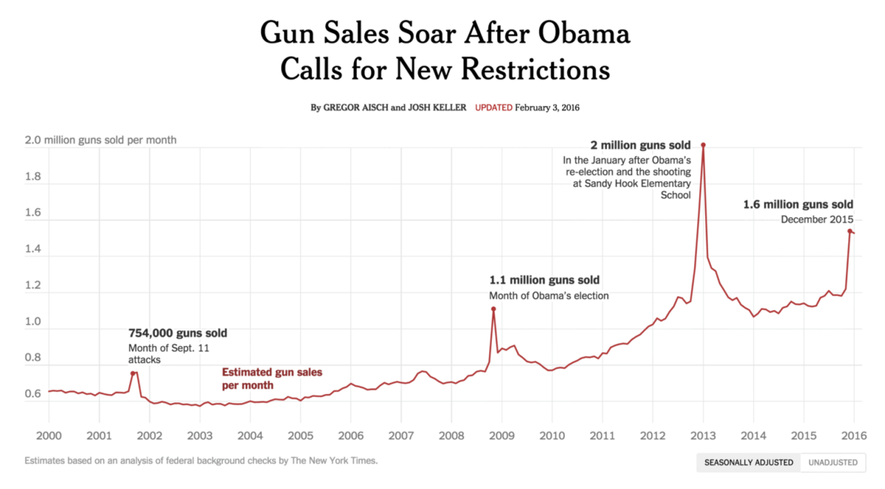
Reading levels: Example
External: “Gun sales”, time, Obama, text labels
Graph from the NY Times, Feb. 3, 2016
Internal: lines, points for labeled events
Relationships: what is the message?
Reading tasks:
Elementary: “How many guns were sold in January of 2013?”
Intermediate: “What’s the trend in gun sales since President Obama was elected?”
Overall: “What’s the overall trend in gun sales in America since the year 2000?”
From: https://medium.com/@karlsluis/before-tufte-there-was-bertin-63af71ceaa62

Slide 22
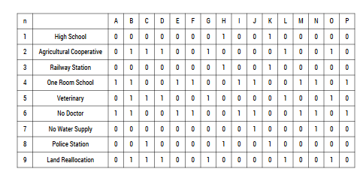
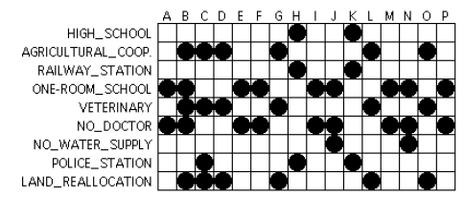
Bertin: The reorderable matrix
A data table: objects by characteristics
Data on facilities of townships, (No:0), (Yes:1)
Both rows and columns are classed (≠,≠) → reorderable
Encode each value by visual attributes
Visual encoding facilitates seeing patterns, trends, anomalies
Notes:
This is something of an aside, but a useful one: How to make better sense of a table of numbers?

Slide 23
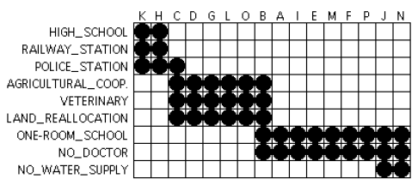
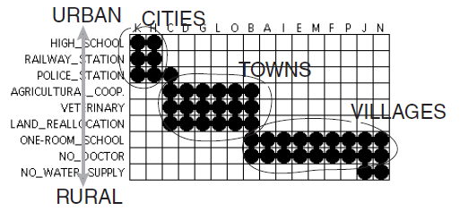
The reorderable matrix
Permute rows and columns to put like with like
This is an early example of what I called “effect ordering” for data display
Interpret row/col order & clusters

Slide 24
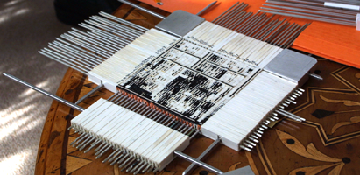
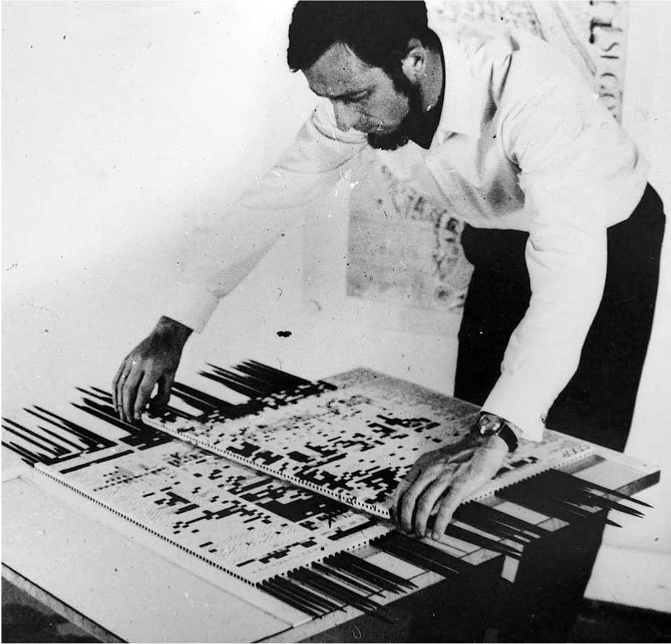
A physical device implementing matrix reordering
This was used by Bertin and others in a large number of applied projects
Bertin was to visual data analysis in France what Tukey was to EDA in N. America

Slide 25
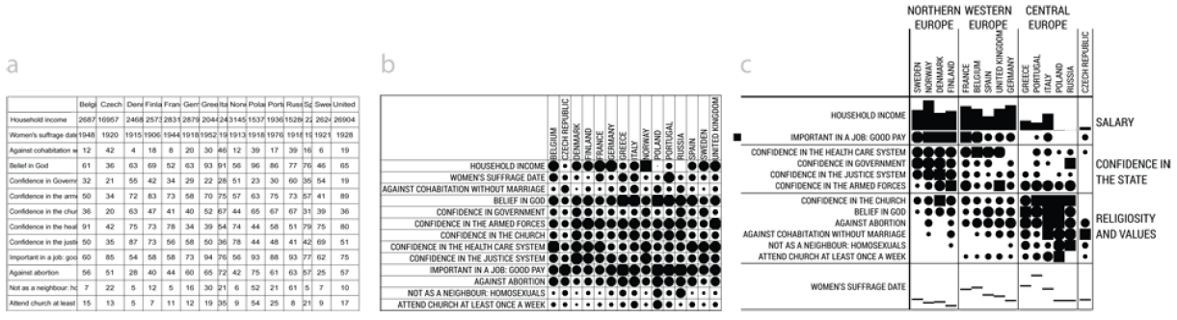
Bertifier
Bertifier: A web app implementing Bertin’s idea of the reorderable matrix
See: http://www.aviz.fr/bertifier
(a) table: Attitudes and attributes by country
(b) Values encoded by size and shape
(c) Sorted and grouped by themes and country regions
Watch: Youtube video of Bertifier, http://youtu.be/tJxAF_a_yBQ

Slide 26
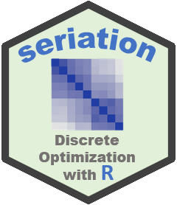
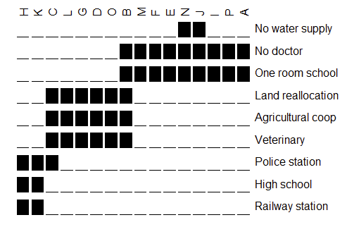
seriate package
Matrix reordering is now recognized as a general problem, with criteria for many different goals, implemented in the seriate package
> list_seriation_methods(kind="matrix")
[1] "AOE" "BEA" "BEA_TSP" "BK_unconstrained“ "CA" "Heatmap"
[7] "Identity" "LLE" "Mean" "PCA" "PCA_angle" "Random" "Reverse"
library(seriation)
data("Townships")
order <- seriate(Townships,
method = "BEA_TSP")
bertinplot(Townships, order)

Slide 27

Heatmaps
Heatmaps are a re-invention of Bertin’s ideas:
Cluster analysis to reorder rows/cols
Shading cells to show some variable
Patients
This example shows a microarray analysis of 128 leukemia patients using 12625 genes.
The goal is to distinguish two types of leukemia
The shading variable is a z-score for how well a given gene distinguishes the two types.
Several clusters of high association are discovered!
Genes
Image source: https://warwick.ac.uk/fac/sci/moac/people/students/peter_cock/r/heatmap/
See also: Wilkinson & Friendly, The History of the Cluster Heat Map, The American Statistician, 2009, 63, 179-184

Slide 28

Heatmaps: the devil is in the details
There are many implementations of “heatmaps”
They differ importantly in the details of: clustering, shading scheme
This example shows a data set of 11 measures on 32 cars from the 1974 Motor Tends magazine
Each variable was converted to z-scores
The value was shaded using a bipolar color scheme
Clusters of cars are slightly separated
The very high and low values stand out
variables
car models
From: http://www.sthda.com/english/articles/28-hierarchical-clustering-essentials/93-heatmap-static-and-interactive-absolute-guide/

Slide 29



Software for computer graphics
How to ask a computer to draw a graph?
data
+
code
→
BEG: “Pretty please, Mr. Computer, draw me a graph”
graphical output

Slide 30


Making graphs: menus vs. syntax
Menu-driven graphics provide a wide range of graph types, with options
What’s wrong with that?
WYSIAYG: What you see is all you get. No way to do something different
Not reproducible: Change the data → Re-do manually from scratch
Often designed by programmers with little sense of data vis

Slide 31



Programming languages: Power & elegance
CS view: All programming languages can be proved to be equivalent (to a Turing machine)
Cognitive view: Languages differ in:
expressive power: ease of translating what you want to do into the results you want
elegance: how well does the code provide a human-readable description of what is done?
extensibility: ease of generalizing a method to wider scope
learn-ability: your learning curve (rate, asymptote)
+
→

Slide 32




Programming languages: Power & elegance
Language | Features:Tools for thinking?
FORTRAN | Subroutines – reusable code Subroutine libraries (e.g., BLAS)
APL, APL2STAT | N-way arrays, nested arrays Generalized reduction, outer product Function operators
Logo | Turtle graphics Recursion, list processing
Lisp, LispStat, ViSta | Object-oriented computing Functional programming
Perl | Regular expressions Search, match, transform, apply
SAS | Data steps, PROC steps, BY processing SAS macros, Output Delivery system
R | Object-oriented methods, tidyverse: dplyr, ggplot2, …
My journey
What did I learn along the way?

Slide 33



Programming languages: Elegance - Logo
Features:
Based on Lisp, but tuned to young minds
Papert: Mindstorms: Children, Computers, and Powerful Ideas (1980)
Turtle graphics: draw by directing a turtle, not by (x,y) coords
Analytic geometry rests on a coordinate system.
Turtle geometry is "body syntonic“: Tell turtle what to do.
Data types:
words, lists, arrays, property lists
Lists & list processing: inherited from Lisp, but with gentler syntax.
Lists are infinitely expandable & nestable.
Recursion rather than iteration is the natural method to process lists
Extensions:
multiple, animated turtles (sprites);
object-oriented programming (message passing) -> SmallTalk

Slide 34


Logo : Turtle graphics
Turtle primitives: forward, back, left, right, penup, pendown, ...
No need for (x, y) coordinates
Just tell a turtle what to do!
How to encapsulate that?

Slide 35




Logo : Procedures
Turtle primitives: forward, back, left, right, penup, pendown, ...
Logo procedures: teach the turtle a new word
> to square :side
repeat 4 [fd :side rt 90]
end
> square 100
Recursive procedures:
> to spiral :size :angle if :size > 100 [stop] forward :size right :angle spiral (:size + 2) :angle end
> spiral 0 90
> spiral 0 91

Slide 36


Logo : Hilbert curves
Logo was more than just pretty pictures
It was graphics & mathematics for young minds: A language for learning
to Hilbert0 :turn :size
right :turn
forward :size
left :turn
forward :size
left :turn
forward :size
right :turn
end
Start with some basic shape
What happens if you replace each line with a smaller copy of the basic shape?
What happens if you continue this process?
What happens if you choose a different basic shape?

Slide 37



Logo : Hilbert curves
depth: 1
depth: 2
depth: 3
depth: 4
depth: 5
to Hilbert :depth :turn :size
if :depth = 0 [stop]
right :turn
Hilbert (:depth-1) -:turn :size
forward :size
left :turn
Hilbert (:depth-1) :turn :size
forward :size
Hilbert (:depth-1) :turn :size
left :turn
forward :size
Hilbert (:depth-1) -:turn :size
right :turn
end
Hilbert curve: A continuous, space-filling fractal, of Hausdorff dimension 2
Theorem (Hilbert, 1891): The euclidean length of the n-th depth Hilbert curve, H_{n} is
Proof (by enumeration): Redefine forward to calculate total turtle path length
to forward.length :size
make "total.length :total.length + :size
forward :size
end

Slide 38


Logo: Tower of Hanoi
Move N disks from one pole to another, with no disk ever resting on a disk smaller than itself.
to Hanoi :n :start :goal :spare # move disks 1:n from START to GOAL
if :n=0 [stop] # are we done?
Hanoi :n-1 :start :spare :goal # move disks 1:n-1 from START to SPARE
move :n :start :goal # move disk n from START to GOAL
Hanoi :n-1 :spare :goal :start # move disks 1:n-1 from SPARE to GOAL
end
A direct translation of an algorithm into code
The Tower of Hanoi problem has an elegant solution in Logo
Change the ‘move’ instruction to render on screen or by a robot!

Slide 39
Graphics programming languages: SAS
SAS: procedures + annotate facility + macros
PROC GPLOT (x,y plots), PROC GCHART, PROC GMAP, …
Annotate: data set with instructions (move, draw, text, fonts, colors)
Macros: Create a new, generic plot type, combining PROC steps and DATA steps.
DATA step
PROC step
PROC GPLOT
results
data class;
input age sex ht wt;
datalines;
20 M 75 152
22 F 69 132
proc glm data=class;
class sex;
model wt = ht sex;
output out=results
p=predict r=resid;
proc gplot data=results;
plot wt * ht = sex;
symbol1 ...
symbol2 ...
Why I gave up SAS: This works well, and is very powerful, but lacks elegance

Slide 40

SAS thinking : many languages
ODS graphics
template language
Output delivery system (ODS)
%macro language
proc iml
matrix language, graphics
procs, Annotate language
SAS/Graph:
Base SAS, SAS/STAT
data step, proc steps

Slide 41


Wilkinson: Grammar of Graphics
Natural language:
Grammar/syntax: What are the minimal, complete set of rules to describe all well-formed sentences?
John ate the big red apple
John big apple red apple ate the
Semantics: How to distinguish meaning, nonsense, poetry in well-formed sentences?
Large green trucks carry garbage
Colorless green ideas sleep furiously
How to apply these ideas to graphics?
Grammar: Algebra, scales, statistics, geometry, …
Semantics: Space, time, uncertainty, …
Needed: a complete formal theory of graphs & computational graphics language
✓
✗
✓
??

Slide 42
Wilkinson: Grammar of Graphics
A complete system, describing the components of graphs and how they combine to produce a finished graphic
“The grammar of graphics takes us beyond a limited set of charts (words) to an almost unlimited world of graphical forms (statements)” (Wilkinson, 2005, p. 1).
“... describes the meaning of what we do when we construct statistical graphics … more than a taxonomy”
“This system is capable of producing some hideous graphics … This system cannot produce a meaningless graphic, however.”
This is a general theory for producing graphs.
the foundation of most modern software systems;
not connected with a theory for reading graphs à la Bertin.

Slide 43
Wilkinson: Grammar of Graphics
Components:
specification: a formal language for composing graphs
assembly: coordination of attributes
internal: a data structure for a graphical “object”
rendering: producing a graphic on a display system
low level: device drivers for screen, PDF, PNG, SVG, …
code
data structure
graphical output

Slide 44

Grammar of Graphics: Specification
Algebra: combine variables into a data set to be plotted
cross (A*B), nest (A/B), blend (A+B), filter, subset, …
Scales: how variables are represented
categorical, linear, log, power, logit, …
Statistics: computations on the data
binning, summary (mean, median, sd), region (CI), smoothing
think: dplyr
SCALE: linear(dim(1))
Notes:
Wilkinson’s ideas for ‘specification’ of graphs turned out to be his most enduring contribution

Slide 45

Grammar of Graphics: Specification
Geometry: Creation of geometric objects from variables
Functions: point, line, area, interval, path, …
Partitions: polygon, contour,
Networks: edge
Collision modifiers: stack, dodge, jitter
Coordinates: Coordinate system for plotting
transformations: translation, rotation, dilation, shear, projection
mappings: Cartesian, polar, map projections, warping, Barycentric
3D+: spherical, cylindrical, dimension reduction (MDS, SVD, PCA)
Notes:
Once the data was assigned scales and possibly summarized with statistics, the next crucial steps were to specify how they could be represented geometrically with points, lines, areas, …
And, then represent those in some visual coordinate system.

Slide 46


Grammar of Graphics: Specification
Aesthetics: mapping of qualitative and quantitative scales to sensory attributes (extends Bertin)
Form: position, size, shape (polygon, glyph, image), rotation, …
Surface: color (hue, saturation, brightness), texture (pattern, orientation), blur, transparency
Motion: direction, speed, acceleration
Sound: tone, volume, rhythm, voice, …
Text: label, font, size, …
Facets: Construct multiplots (“small multiples”) by partitioning, blending or nesting
Guides: Allow for reading the encodings of variables mapped to aesthetics
scales: axes, legend (labels: size, shape, color, …)
annotations (title, footnote, line, arrow, ellipse, text, …)
Notes:
The final steps for Lee were to assemble these into aesthetic mappings of Bertin’s visual variables and then render those to a display device

Slide 47
Grammar of Graphics: Implementation
Wilkinson illustrates the GoG with a programming language (GPL: the Graphics Production Language)
GPL statements
DATA: expressions that create variables to display from data sets
TRANS: variable transformations prior to plotting (e.g., ranking the data points)
ELEMENT: define graphical elements (e.g., points, lines, …) and their aesthetic attributes (e.g., shape, color, …) to use in the display
SCALE: apply scale transformations to the plot (e.g., square root or log)
COORD: select the coordinate system for use in the graphic (e.g., Cartesian, polar)
GUIDE: guides to aid interpretation (axes, legends)

Slide 48

GPL example: scatterplot
A simple scatterplot of the Iris data, points colored by species
DATA: x = "SepalLength"
DATA: y = "SepalWidth"
DATA: z = “Species"
TRANS: x = x
TRANS: y = y
ELEMENT: point(position(x*y), color(z))
COORD: rect(dim(1,2))
SCALE: linear(dim(1))
SCALE: linear(dim(2))
GUIDE: axis(dim(1), label("Sepal Length"))
GUIDE: axis(dim(2), label("Sepal Width"))
TRANS, SCALE, COORD and GUIDE all show the defaults & aren’t necessary here.
The key one is ELEMENT, specifying points, positioned by (x*y) and colored by z
SPSS graphics now use GPL as the backend (syntax) for their graphics engine

Slide 49

GPL example: contour plot
A smoothed contour plot of birth rate vs. death rate for selected countries
ELEMENT: point(position(birth*death), label(country))
ELEMENT: contour(position(smooth.kernel.density(birth*death)), color.hue())
GUIDE: form.line(position((0,0), (30,30)), label(“Zero population growth”))
GUIDE: axis(dim(1), label(“Birth rate"))
GUIDE: axis(dim(2), label(“Death rate"))
Wilkinson, Grammar of Graphics, Fig 1.1

Slide 50

GPL syntax
The essential features of a graph are described by ELEMENT
The geometrical objects (point, line, interval, …) are specified within this
Their visual properties (position, color) and statistical summaries are given as well
Some typical graph types:
From: Pere Milán, Imagining data with ggplot2, QM Forum presentation, Nov. 23, 2015

Slide 51

GPL in SPSS syntax
GGRAPH
/GRAPHDATASET NAME="graphdataset" VARIABLES=read write
/GRAPHSPEC SOURCE=INLINE.
BEGIN GPL
SOURCE: s=userSource(id("graphdataset"))
DATA: read=col(source(s), name("read"))
DATA: write=col(source(s), name("write"))
GUIDE: axis(dim(1), label("reading score"))
GUIDE: axis(dim(2), label("writing score"))
ELEMENT: point(position(read*write))
END GPL.
SPSS menu choices → GPL code
You can:
Extract the code
Tweak it
Save to make it reproducible
https://stats.oarc.ucla.edu/spss/library/spss-librarymaking-graphs-with-the-ggraph-command-and-gpl/

Slide 52

Facets & frames
Tables of graphs:
Facets: → graphs of subset
Frames: → separate graphs
Linked micromap:
Population density of US, divided in octiles
States in each octile shown separately
GoG was a coherent language for specifying and producing nearly all known graphic forms.

Slide 53
Colorless green graphs sleep furiously
JSM 2017: Dinner with Lee Wilkinson, Howard Wainer, Paul Vellman, & others
The great debate:
LW: The GoG is a complete theory, a formal mathematical model comprehending all graphs.
"Beauty is truth, truth beauty,"--that is all Ye know on earth, and all ye need to know.
MF: There is more--
Implementation matters: translating a graphic idea into a finished graph should be facilitated by the language of graphic code.
A productive language for graphs should encompass the steps of data analysis
Pere Milán: A truly expressive graphic language should recommend the right graphic(s) to “get the message home”
See: Friendly (2022), Colorless Green Graphs Sleep Furiously: A Conversation with Leland Wilkinson, https://bit.ly/3m5eJKF

Slide 54




Wickham: ggplot2
ggplot2: Elegant graphics for data analysis
a computational language for thinking about & constructing graphs
sensible, aesthetically pleasing defaults
+ themes: default, bw, journal, tufte, …
infinitely extendable
ggplot extensions: https://exts.ggplot2.tidyverse.org/

Slide 55


Wickham: ggplot2
Implementation of GoG in R as layers of a graphic
Basic layers:
Data,
Aesthetics (data → plot mapping)
Geoms (points, lines, bars, …),
Statistics: summaries & models
Coordinates: plotting space
Facets: partition into sub-plots
Themes: define the general features of all graphical elements

Slide 56

ggplot2: data + geom = graph
Every graph can be described as a combination of independent building blocks, connected by “+” (read: “and”)
data: a data frame: quantitative, categorical; local or data base query
aesthetic mapping of variables into visual properties: size, color, x, y
geometric objects (“geom”): points, lines, areas, arrows, …
coordinate system (“coord”): Cartesian, log, polar, map,
ggplot(FMA,
aes(x=F, y=A, color=F, size=A) +
geom_point()

Slide 57

ggplot2: data + geom = graph
ggplot(data=mtcars, 
aes(x=hp, y=mpg, 
color=cyl, shape=cyl)) + 
geom_point(size=3) 
In this call:
data=mtcars: data frame 
aes(x=, y=): plot X,Y variables 
aes(color=, shape=): attributes 
+ geom_point(): what to plot 
the coordinate system is taken to be the standard Cartesian (x,y)
a corresponding legend is automatically generated

Slide 58

ggplot2: geoms
Wow! I can really see something there.
How can I enhance this visualization?
Easy: add a geom_smooth() to fit linear regressions for each level of cyl
ggplot(mtcars, aes(x=hp, y=mpg, color=cyl, shape=cyl)) +
geom_point(size=3) +
geom_smooth(method="lm", aes(fill=cyl))

Slide 59

ggplot2: GoG -> graphic language
The implementation of GoG ideas in ggplot2 for R created a more expressive language for data graphs
layers: graph elements combined with “+” (read: “and”)
themes: change graphic elements consistently
ggplot(mtcars, aes(x=hp, y=mpg)) +
geom_point(aes(color = cyl)) +
geom_smooth(method ="lm") +

Slide 60

ggplot2: more geoms
ggplot2 facilitates graphical thinking by making a clear separation among:
mapping data variables to plot features (aes());
geometric objects (geom_())
statistical summaries (stat_())

Slide 61

ggplot2: layers & aes()
Aesthetic attributes in the ggplot() call are inherited by geom_() layers
Other attributes can be passed as constants (size=3, color=“black”) or
with aes(color=, …) in different layers
This plot adds an overall loess smooth to the previous plot
ggplot(mtcars, aes(x=hp, y=mpg)) +
geom_point(size=3, aes(color=cyl, shape=cyl)) +
geom_smooth(method="lm", aes(color=cyl, fill=cyl)) +
geom_smooth(method="loess", color="black", se=FALSE)

Slide 62

ggplot2: themes
All the graphical attributes of ggplot2 are governed by themes – settings for all aspects of a plot
A given plot can be rendered quite differently just by changing the theme
If you haven’t saved the ggplot object, last_plot() gives you something to work with further
last_plot() + theme_bw()

Slide 63




ggplot2: themes
Built-in ggplot themes provide a wide variety of basic graph styles
Other packages provide custom themes, or you can easily define your own
theme_hc()
theme_economist()
theme_bluewhite()

Slide 64

ggplot2: facets
Facets divide a plot into separate subplots based on one or more discrete variables
plt <-
ggplot(mtcars, aes(x=hp, y=mpg, color=cyl, shape=cyl)) +
geom_point(size=3) +
geom_smooth(method="lm", aes(fill=cyl))
plt + facet_wrap(~gear)
Syntax:
facet_wrap(rowvar ~ colvar)

Slide 65

ggplot2: extensions
ggplot2 provides a prototype system for implementing new geoms, stats, themes, …
Many of these are listed at https://exts.ggplot2.tidyverse.org/

Slide 66


ggplot2: extensions
ggplot2 provides a prototype system for implementing new geoms, stats, themes, …
Many of these are listed at https://exts.ggplot2.tidyverse.org/

Slide 67





ggplot2: extensions
ggwordcloud
ggridges
ggstatsplot
The wide range of extensions indicates the power of ggplot2 as a general framework for data graphics

Slide 68
gganimate: A grammar of animation
gganimate extends ggplot2 grammar to include a structured description of animation.
→ New grammar classes added to a plot object specify how it should change with time.
transition_*() how data should change and how it relates to itself across time.
view_*() how positional scales should change along the animation.
enter_*()/exit_*() how new data appear, and old data disappear over the animation.
ease_aes() defines how different aesthetics should change over transitions

Slide 69


Goal: Produce an animation of Rosling’s gapminder data, showing how life expectancy varies with GDP per capita.
Stratify by continent: facet_wrap(~continent)
Animate this by Year: transition_time(year)

Slide 70
Basic bubble plot by continent: lifeExp ~ gdp;
size ~ population;
facet ~ continent
library(gapminder)
ggplot(gapminder, aes(gdpPercap, lifeExp, size = pop, colour = country)) +
geom_point(alpha = 0.7, show.legend = FALSE) +
scale_colour_manual(values = country_colors) +
scale_size(range = c(2, 12)) +
scale_x_log10() +
facet_wrap(~continent) +
Animate this:
change frame title;
transition over year;
interpolate linearly
labs(title = 'Year: {frame_time}’,
x = 'GDP per capita', y = 'life expectancy') +
transition_time(year) +
ease_aes('linear')
interpolate linearly

Slide 71

Going Meta: Graphic notation
How do different software graphic languages make it easier or harder to produce the graph I want?
From: Nicolas Kruchten, Usability of Visualization Notations

Slide 72


Meta: Comparing graphic notation
Graphs can be produced in a variety of software languages:
R, ggplot2, D3, Vega-Lite, matplotlib, Seaborn, Plotly, …
How do they differ is ease of use, efficiency of expression?
Cognitive dimensions of notations?
viscosity (how easy to make changes to specifications),
abstraction (how easy to extend the notation),
closeness of mapping (how similar notation to target domain),
progressive evaluation (how easy to check work done to date),
hard mental operations (how demanding notation is of working memory).
https://en.wikipedia.org/wiki/Cognitive_dimensions_of_notations

Slide 73

Software metrics
Generate a collection of graph types
Code each in a variety of specification languages & implementations
Calculate metrics for each:
Terseness: # characters in code for given graph
Economy: Size of vocabulary (operators, functions, …) to combine/add new stuff
Viscosity: How hard to change one notation to another?

Slide 74

Notascope
https://app.notascope.io/ - Online tool to demonstrate the metric-driven approach to graphic software evaluation

Slide 75

Evaluate, Analyze
Given a collection of graphs, implementations and metrics, we can better understand the how software languages differ in translation from IDEA → CODE → GRAPH

Slide 76

A larger view: Data science
Data science treats statistics & data visualization as parts of a larger process
Data import: text files, data bases, web scraping, …
Data cleaning → “tidy data”
Model building & visualization
Reproducible report writing

Slide 77


The tidyverse of R packages
These ideas inspire a larger view of data analysis and graphics based on tidy principles.

Slide 78






The tidyverse expands

Slide 79
Summary
Graphical developers in the Golden Age recognized the idea of “graphic language,” but could not define it.
Bertin first formalized the relations between graphical features (“retinal variables”), data attributes (O, Q, ≠, ≡), and “reading levels”
Wilkinson, in GoG, created a comprehensive syntax and algebra to define any syntactically correct graph
Wickham, in ggplot2, created an expressive language to ease the translation of graphic ideas into plots.
More general views can evaluate usability of graphic notations
Tidyverse ideas place data analysis & graphics within a communication-oriented, reproducible research framework.

